Slide 1
Facing a Different Future ?
25th October 2023
Councillor Andrew Mellen
Leader – Mid Suffolk District Council
District Councillor – Bacton Ward
Cabinet Member – Performance & Resilience
andrew.mellen@midsuffolk.gov.uk

Slide 2
Climate change
Biodiversity
Resource constraints
Workforce / skills issues
Migration
Political change

Slide 3
Mid Suffolk new Green administration
= new priorities

Slide 4

Our Priorities
Environmental responsibility
We want to reduce waste down close to zero
Improve biodiversity
Focus on securing local community food and energy production, and water supply
Develop a greener skilled economy and improve sustainability in the built environment
We want to achieve net zero carbon emissions (as a Council, and across the whole district)

Slide 5

Our Priorities
Social Responsibility
Increasing the availability of truly affordable homes
Improving people's physical and mental wellbeing
Harnessing our district’s fantastic heritage and culture
Improving rural transport
Supporting small rural businesses
Tackling inequalities and helping everyone feel proud of where they live.
Deeper, more meaningful community engagement

Slide 6
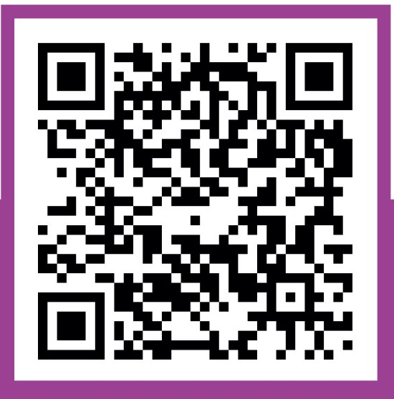
Get involved…
From 4th October to 15th November
The engagement includes:
Scan our QR code to respond to online survey
Business Newsletter (sent to over 800 subscribers)

Slide 7

