Slide 1



Welcome to your Central Suffolk Place Forum
Jenny Cousins
(Guest Chair)
The Food Museum

Slide 3
Why Social Value is Important Toby Warren Senior Policy Officer Suffolk Chamber of Commerce

Slide 4
What is social value?
Put simply, social value is an umbrella term for capturing the full net value an organisation provides to society.
This can include how an organisation supports the local economy, for example by helping local people into employment or buying from other local businesses; or activities that provide other benefits, such as promoting opportunities for disadvantaged groups or reducing waste.
Social value embraces both CSR (Corporate Social Responsibility) and ESG (Environmental, Social and Governance).
70% of employees say they would not work for a company without a strong purpose, customers are four times more likely to buy from a company with a strong purpose.
How we do business is as important as what we do

Slide 5
Business benefits of social value
Win and retain customers, as they will want to trade with an organisation that is clearly making a positive contribution to the wellbeing of Suffolk.
Recruit and retain talented people, as they will feel pride and purpose in working for an organisation that is clearly making a positive contribution to the wellbeing of Suffolk.
The Public Services (Social Value) Act 2012, allows local authorities to take into consideration, in the award of contracts, any offer of additional community benefit which is over and above the specified requirements, where these meet the local authority’s priorities.
For Suffolk County Council social value helps to maximise the ‘Suffolk £’, develop growth in the local economy, improve our environment and health, wellbeing and safety by building stronger community resilience, mobility and improving educational attainment.

Slide 6
Social value themes

Slide 7
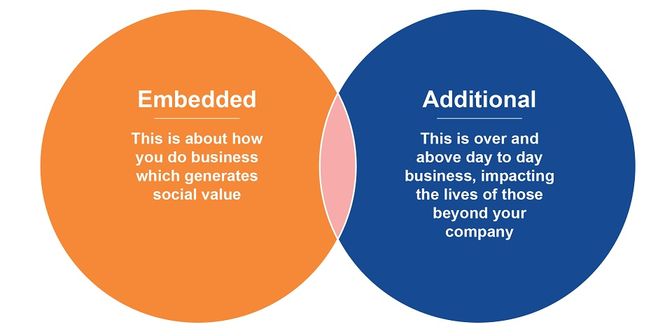
Two types of social value

Slide 8
Suffolk Chamber of Commerce delivering social value
How we contribute
to economic wellbeing
How we help
our community
How we improve our environmental impact
What we do | How we make it happen | How we evidence it
Buy locally | Use local supply chains | £s spent with members
Provide business advice | Employ Business Support & Int. Trade teams | Numbers advised
Identify skills needs | Employer consultation | Local Skills Improvement Plan
Provide work experience | Policy | Number of placements
Promote links between health & productivity | Improving Workplace Health Hub | Number of businesses visiting hub & attending events
What we do | How we make it happen | How we evidence it
Promote equality | Policy, gender equality business pledge & disability confident employer | Staff diversity
Employ locally | Recruit locally | % local staff
Find work for disadvantaged young people | Manage Kickstart scheme | Number of placements
Promote veterans employment | Armed Force Covenant | % staff ex-armed forces
Staff volunteering | Policy | Number of volunteering days
Charitable fund raising | Prestige dinner & other events | £s raised
What we do | How we make it happen | How we evidence it
Reduce SCoC carbon | Policy & action plan | Carbon Charter accreditation
Minimise SCoC waste | Policy & action plan | Measure waste reduction
Promote business benefits of reducing carbon | Net Zero Hub | Number of businesses visiting hub & attending events

Slide 9
Providing evidence of your social value
How are you contributing to economic wellbeing?
How are you reducing your environmental impact?
How are you helping your community?
Put together case studies – Showing not just what you do, but also how you make it happen
e.g.
What we do - Buy locally
How we do it – Examples of your local supply chains
Use the case studies to promote your business and win new customers

