Slide 1



Challenges of switching to EV
10 October 2023
Suzanne Buck – Head of Strategy & Tech Prog

Slide 2






Challenges switching to EV
What infrastructure, and where
Barriers to delivery
Behaviour

Slide 3
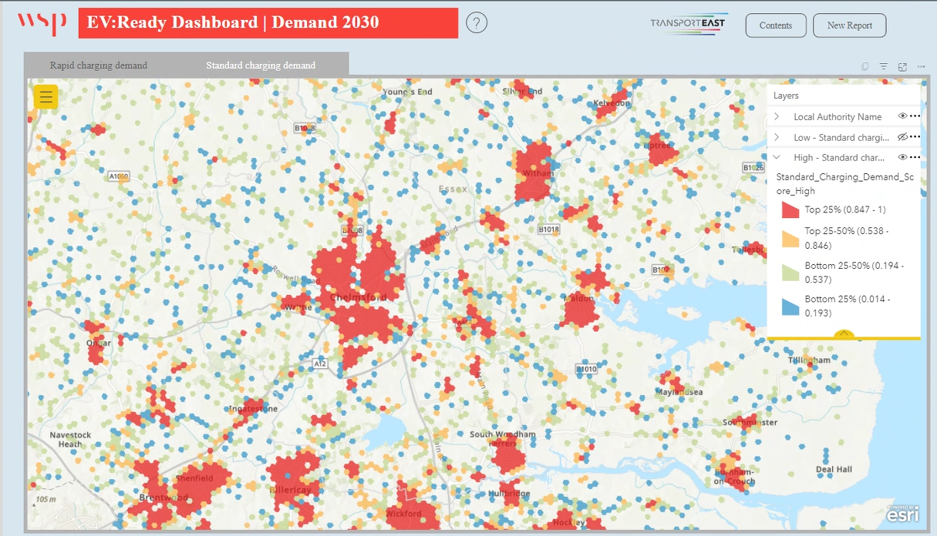
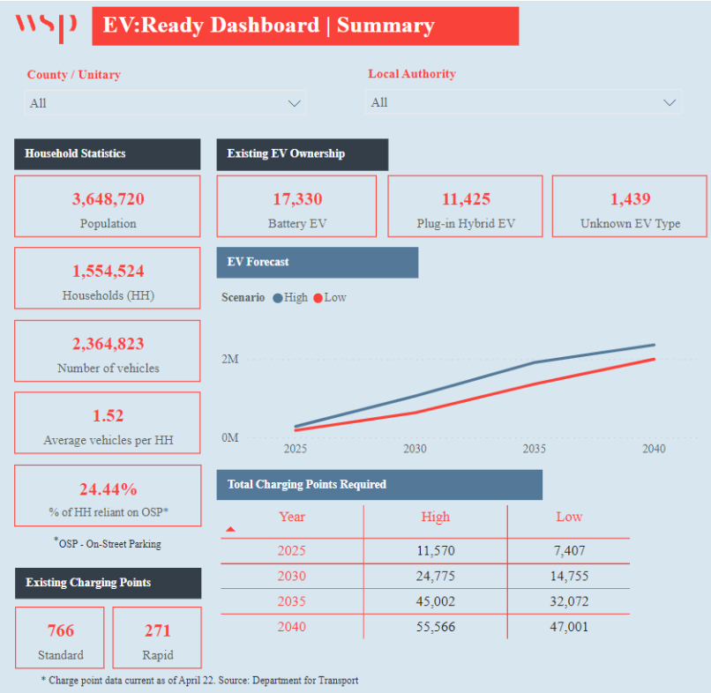
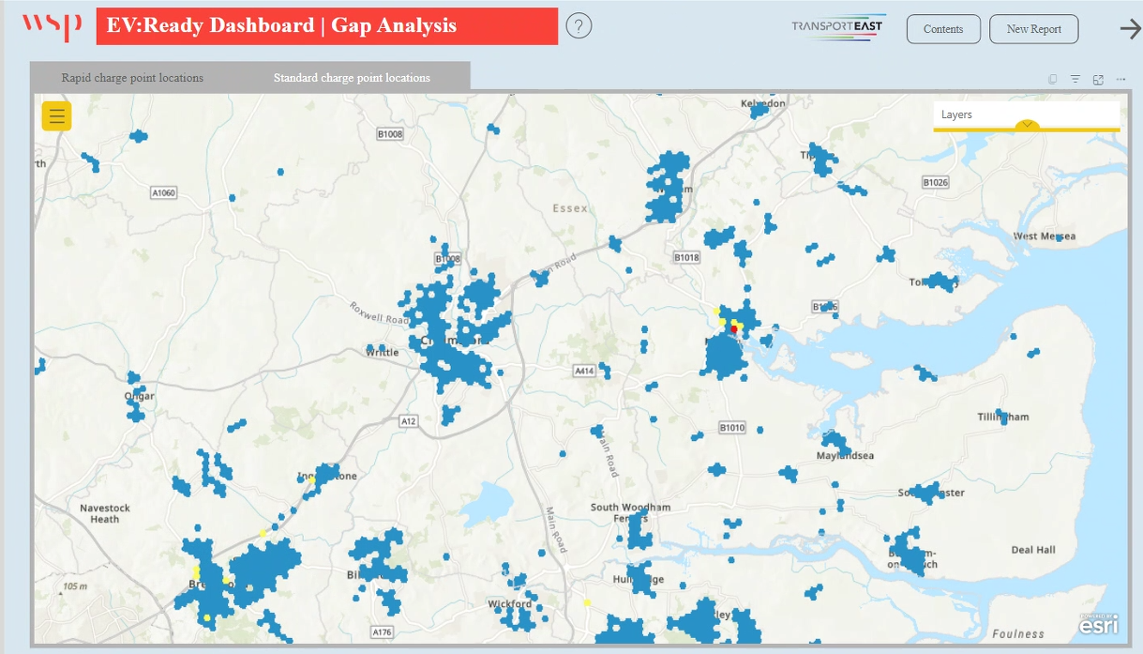
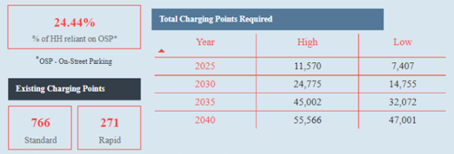
What infrastructure and where

Slide 4
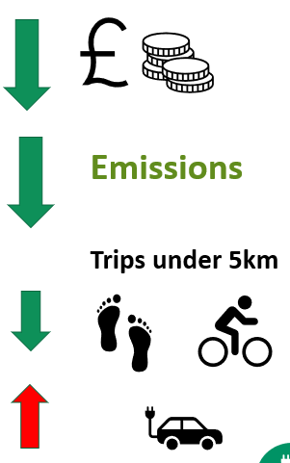
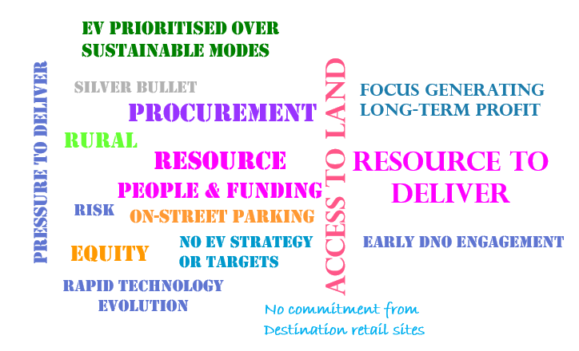

Barriers to delivery
Behaviour

Slide 5

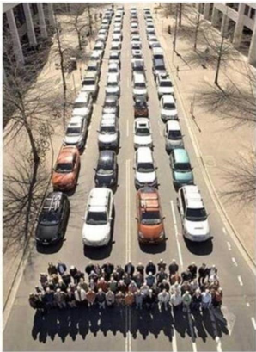
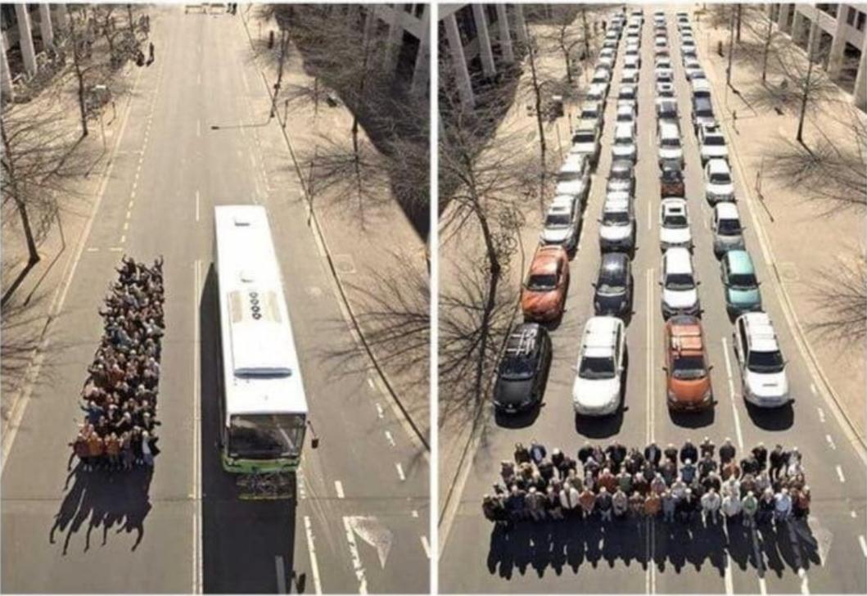
What Next?
What infrastructure where Roll out EV:Ready Tool
Set targets
Barriers to delivery
ID procurement best practice
Let’s talk land
Resource
Behaviour
EV part of integrated solution
ICE Vehicles
EV
Shift Modes

