Slide 1
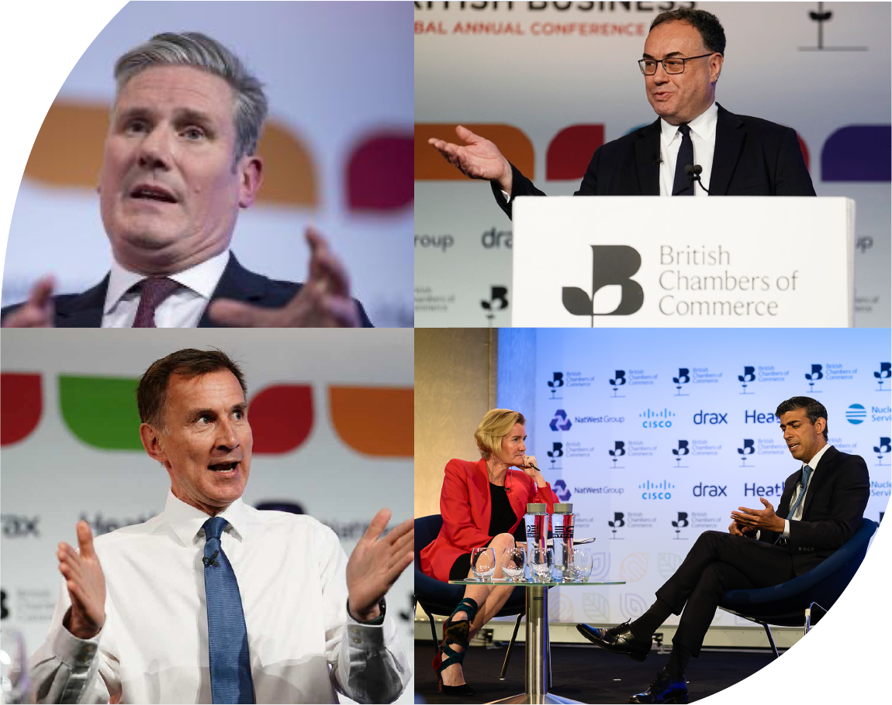


Fiscal & Monetary Policy A National Perspective Jonny Haseldine BCC
13th February 2024

Slide 2
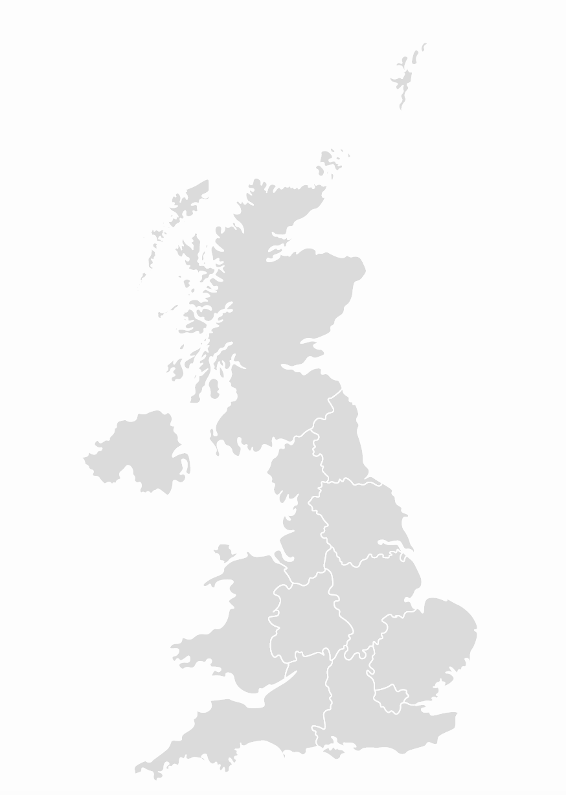
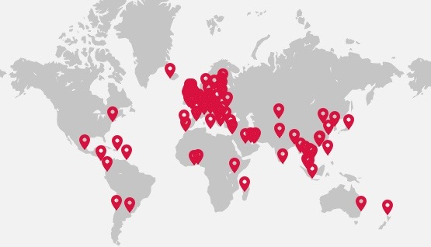
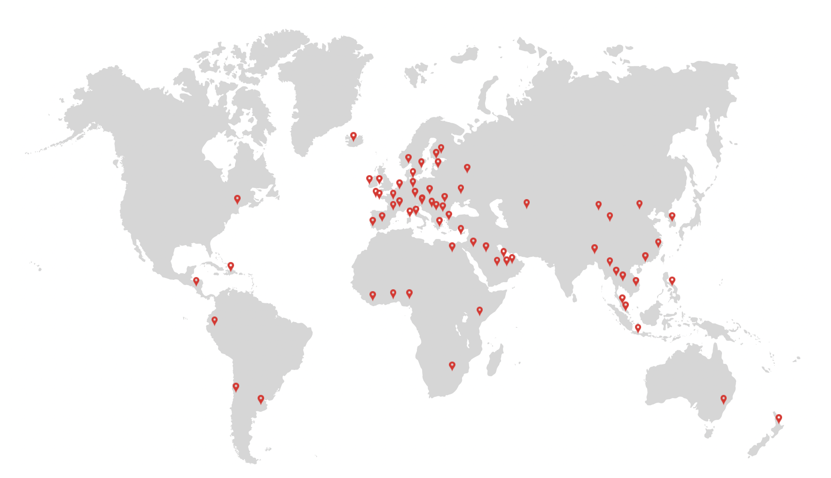

Our Reach
80 +
We’re all over the world
Members of our growing international network
INTERNATIONAL CHAMBERS
UK CHAMBERS
56K companies, 6m employees in UK
53
Accredited Chambers of Commerce in the UK
17K companies, 18 m employees around the world

Slide 3
Policy development: Current structure
BCC National Policy Groups
Employment & Skills
Economy & Tax
Climate
Professional & Financial Services
Infrastructure
Trade
Devolved Nations
BCC / Chamber Expert Panels
1. Planning
2. Employment
3. Tax
Economic Advisory Council (EAC)
Policy Steering Group – all 53 Chambers
Approved BCC Policy
Notes:
Policy groups and Expert Panels are open to Chamber Staff and Members.
Chambers ideally consult their members prior to discussions in BCC policy committees

Slide 4
Policy Development
Reaching Consensus
BCC will ensure | We will achieve this by:
A joined-up approach and a consensus view | Ensuring there is a constant feedback loop between all the policy groups
Chambers are fully involved | Chamber representative on the Business Council Chambers invited to be represented on the 5 Challenges
Structures & review process are in place | BCC Policy Director accountable Review process 6 months in
Policy Steering Group
Business Council
5 Challenges
Policy Groups & Expert Panels
BCC Policy

Slide 5

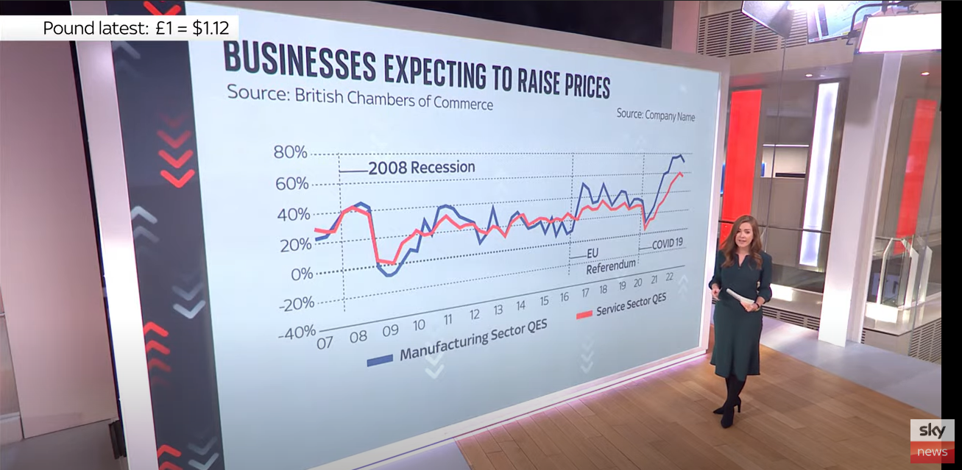
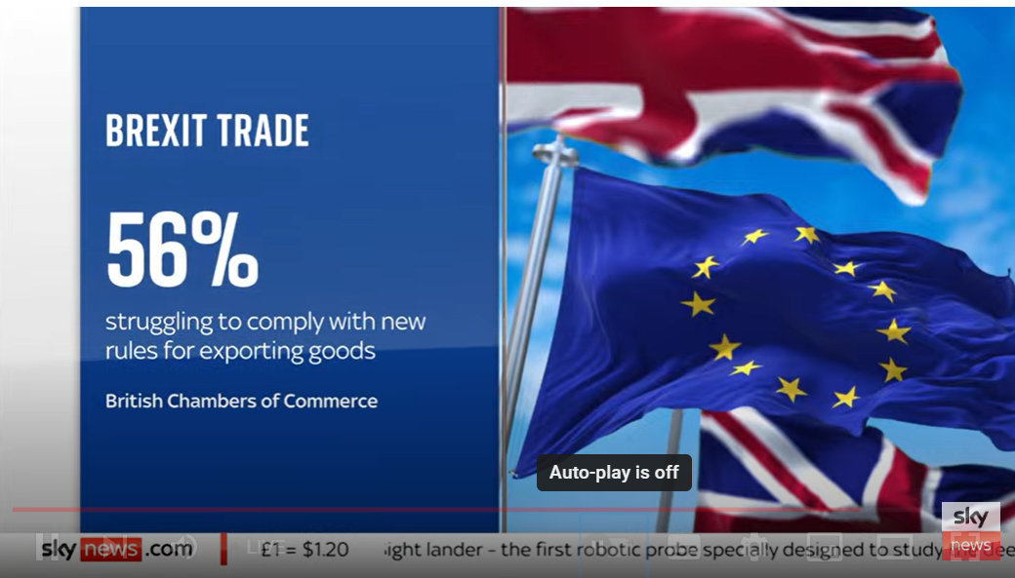
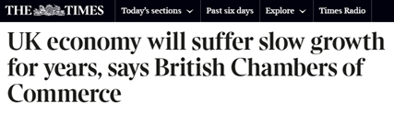
The BCC Insights Unit
BCC and Chamber Network run a leading research programme on UK business sentiment and economic conditions.
Quarterly
Economic Survey
click here
Quarterly
Economic Forecast
click here
Thematic
Surveys
click here
Established in 1989, the UK’s largest and longest-running independent business sentiment survey.
A forecast of key macro-economic indicators in the UK, ranked joint-second most accurate by the Times.
In-depth business surveys on topics such as trade, skills, and net zero.

Slide 6

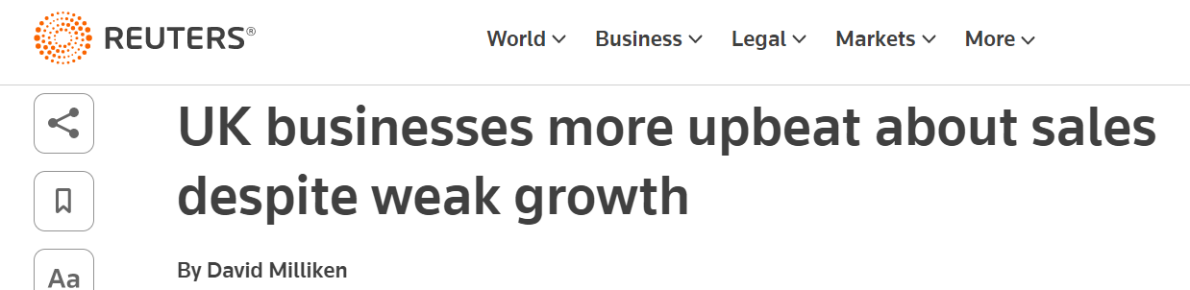
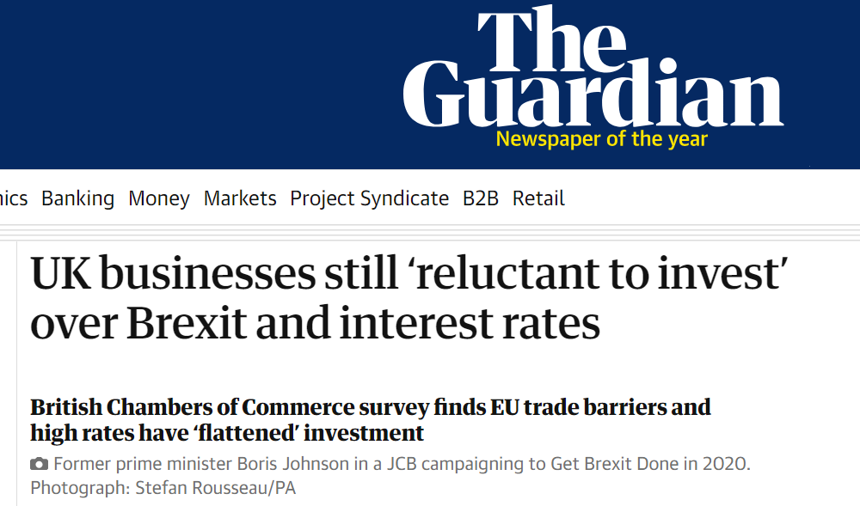
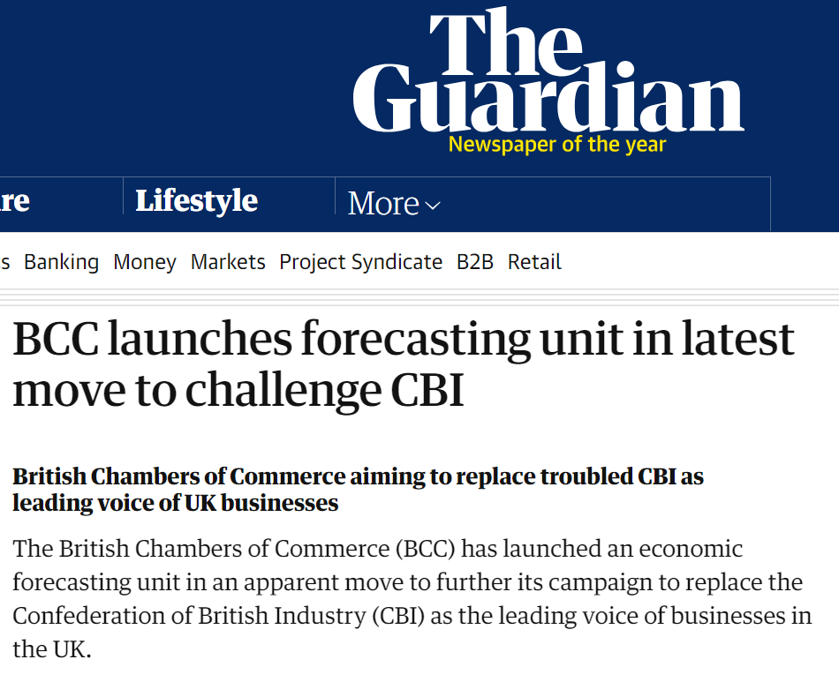
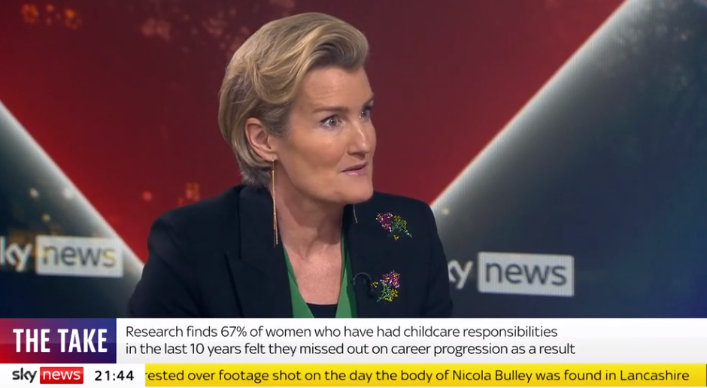
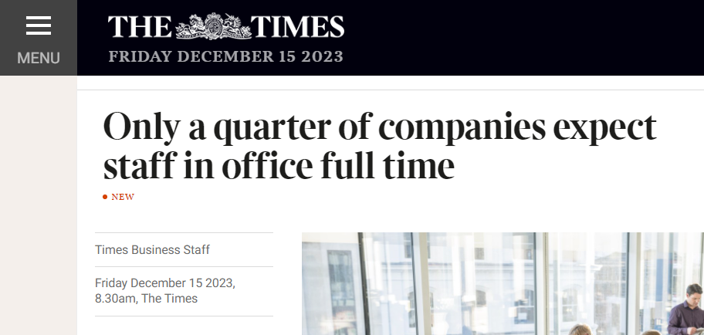
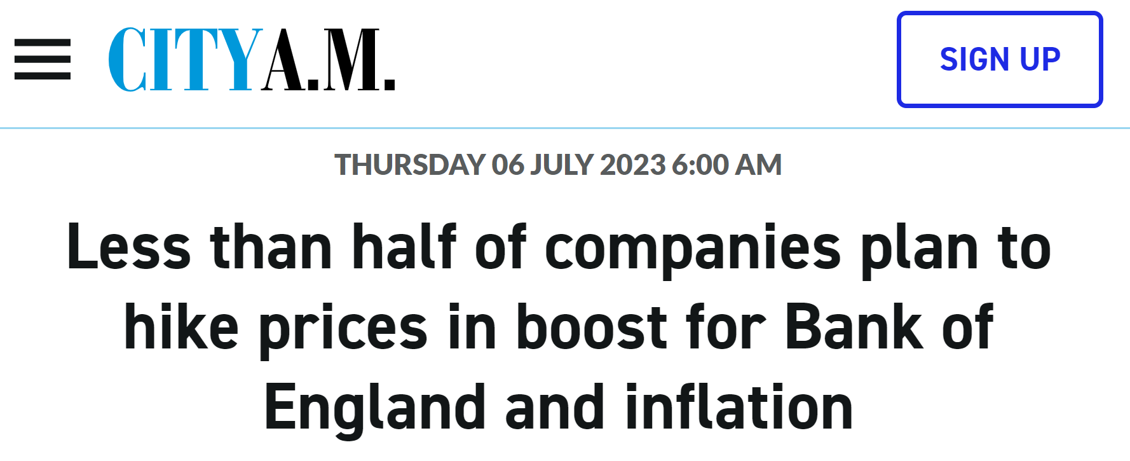
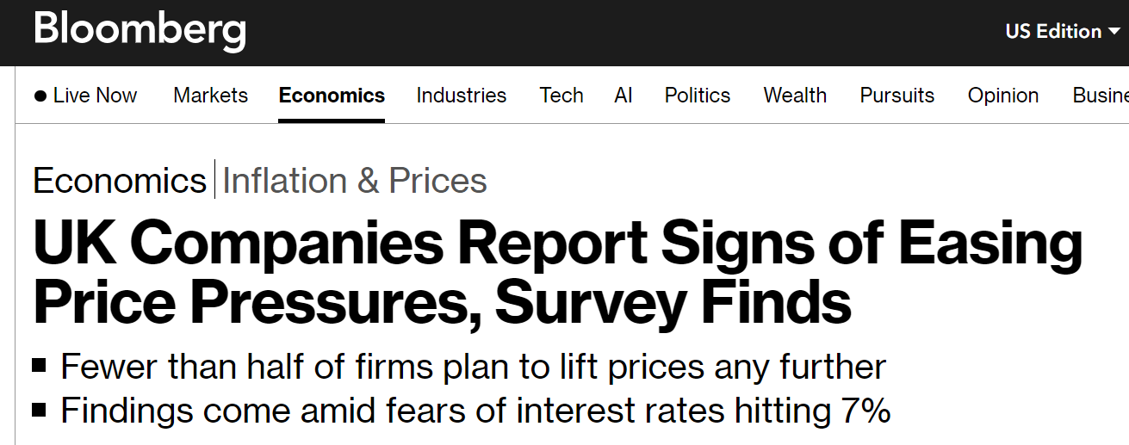
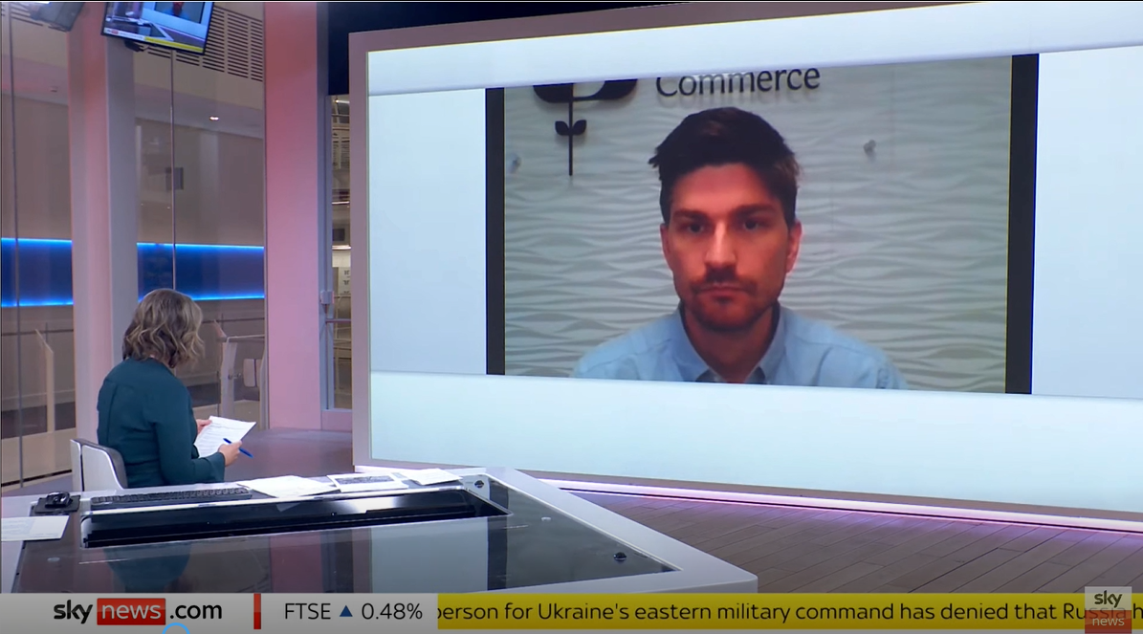
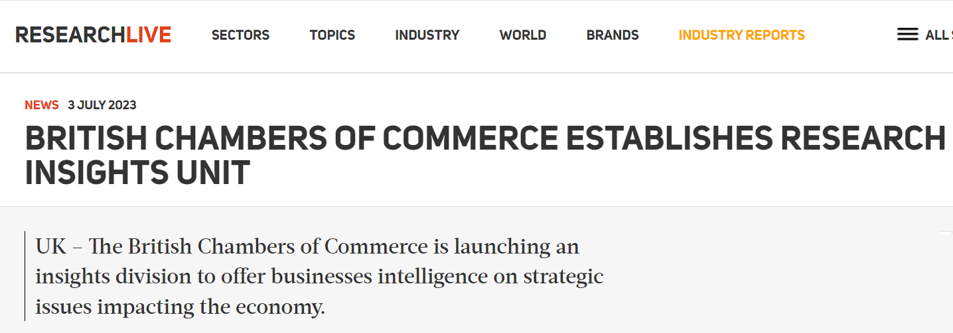
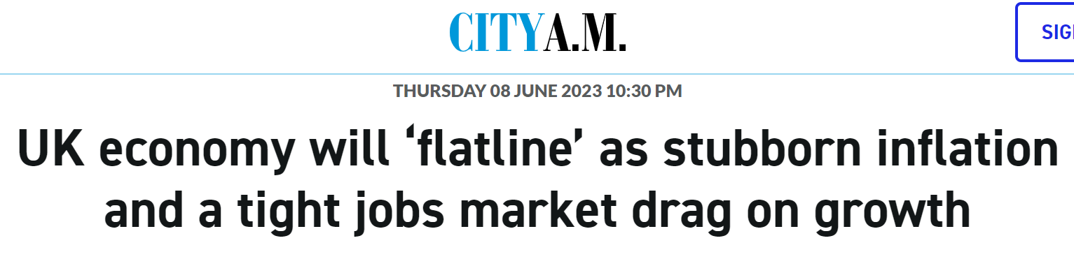
2023 in press coverage

Slide 7
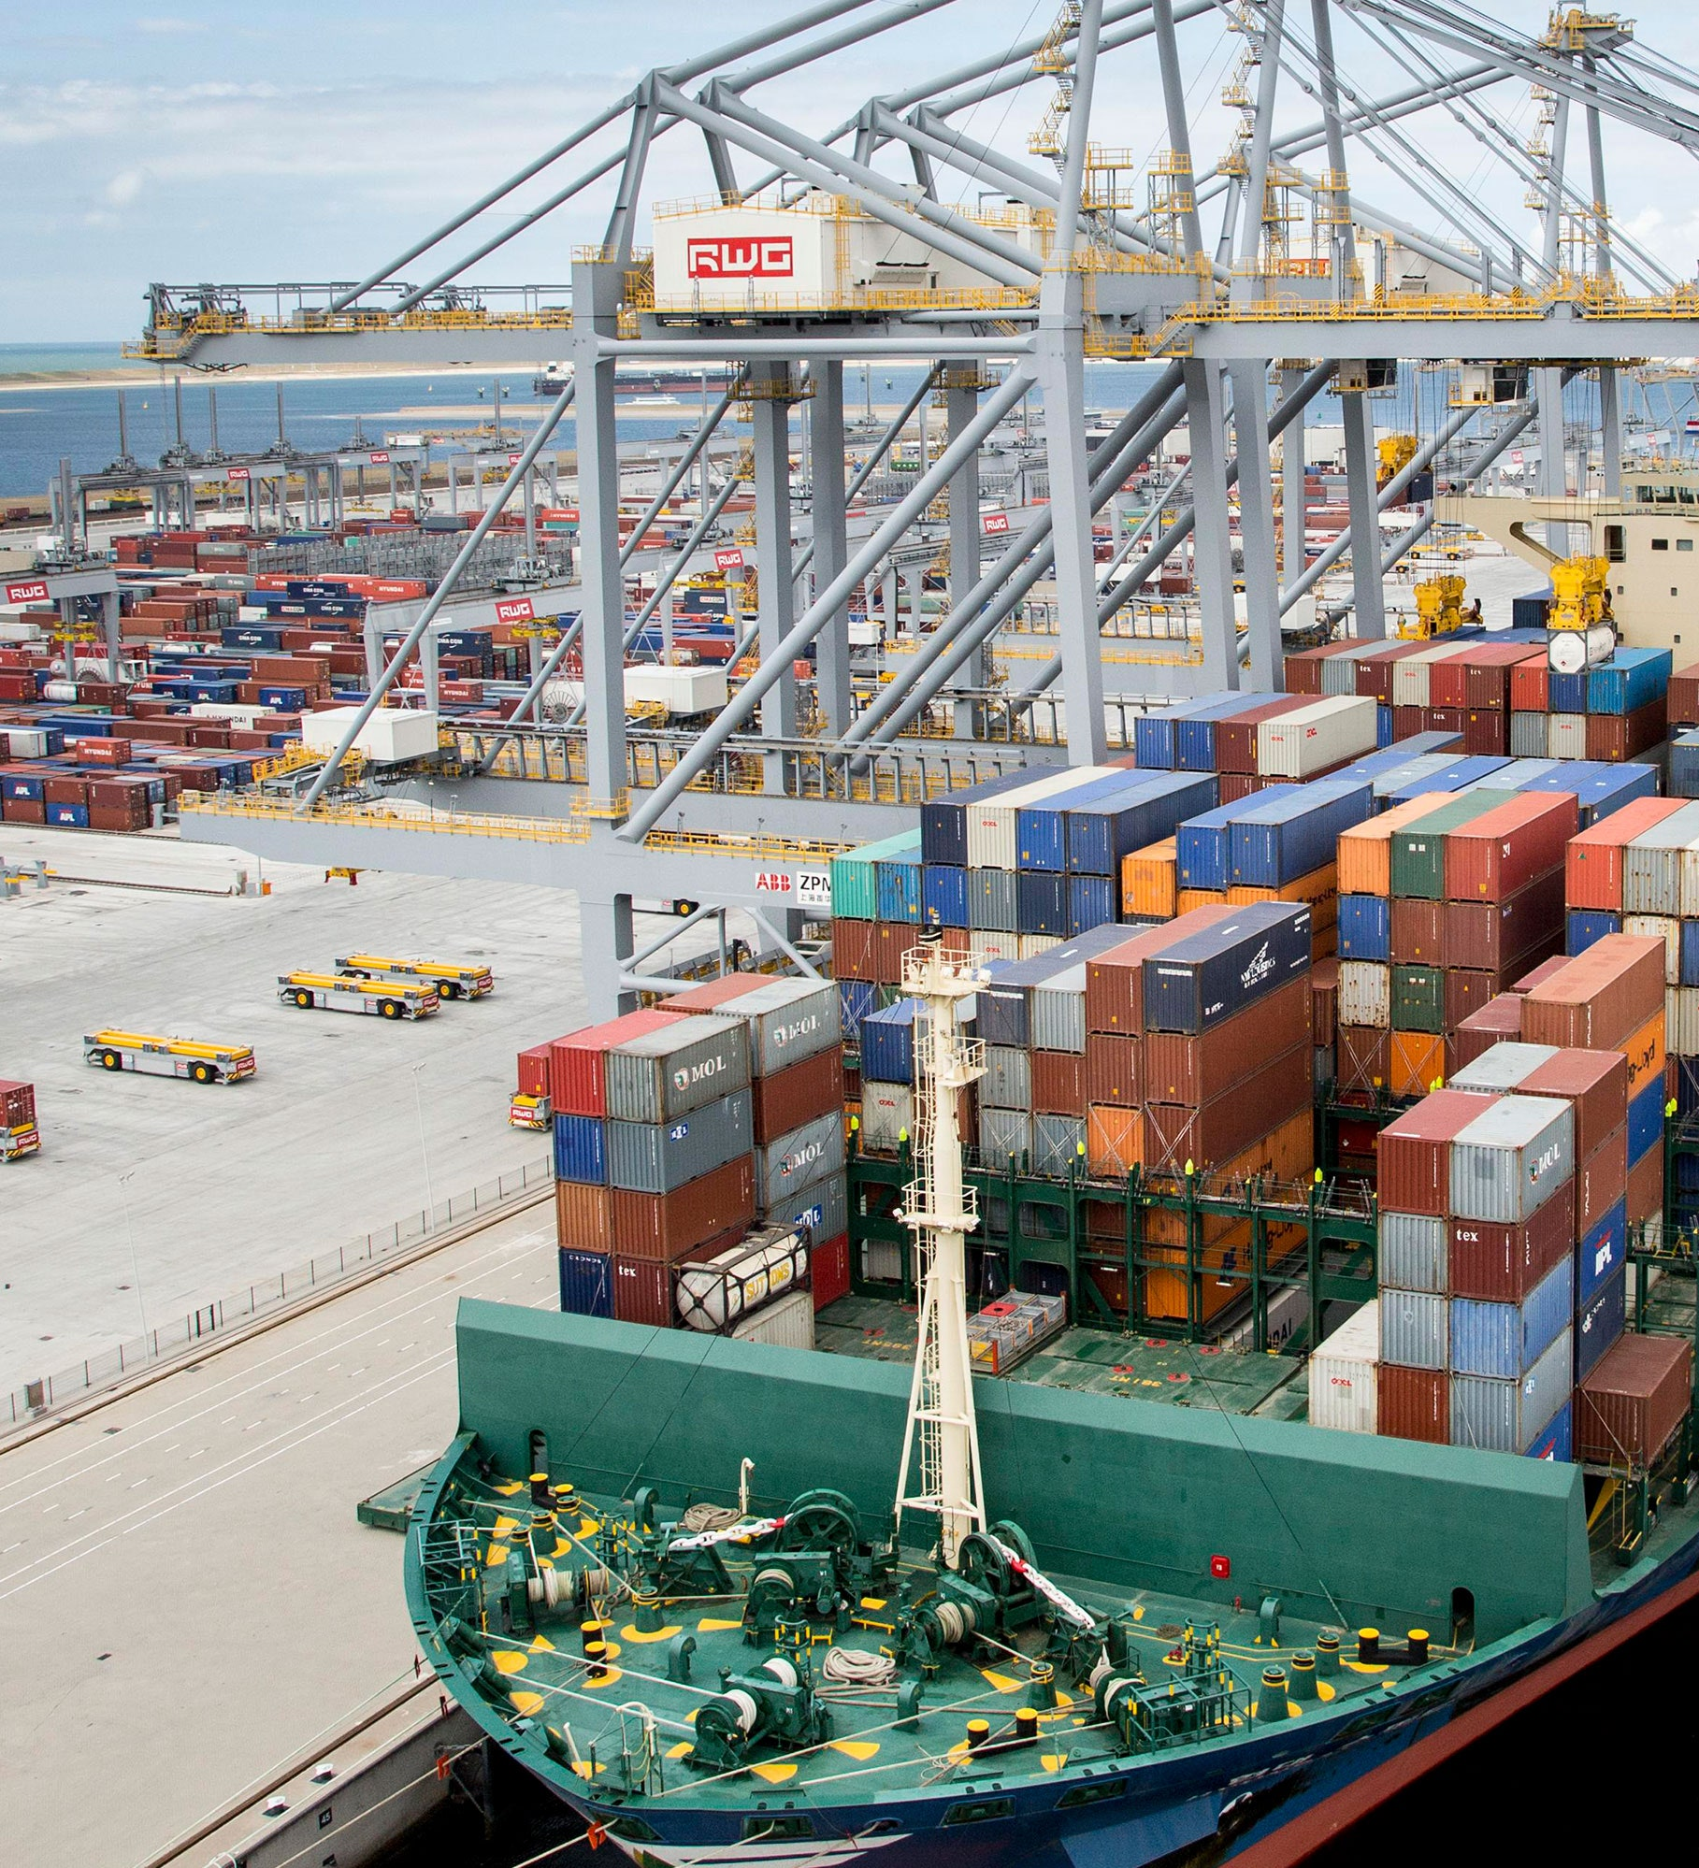





QES Q4 2023
Minor improvement in overall business conditions, with slight increase to business confidence, though results would be consistent with low growth narrative
Downward trend in price expectations halts
Slightly fewer firms cite interest rates as a concern
Labour market remains tight for most firms
Hospitality sector in recession conditions
Please note, results can vary significantly depending on the size and sector of business

Slide 8
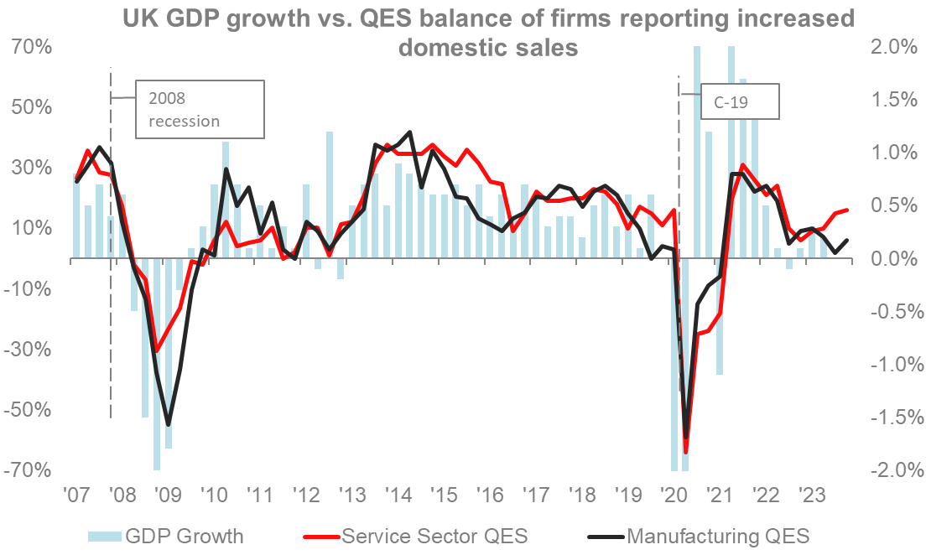
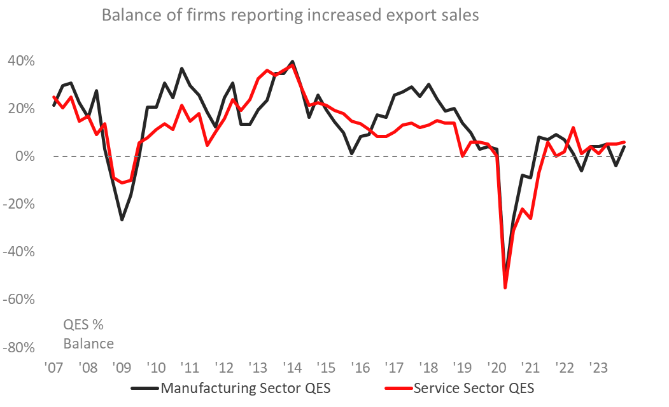
Business conditions indicators improve slightly…
…with the proportion of firms reported increased domestic sales and exports growing, albeit from a low base. B2B service sector firms are the most likely to report increases to domestic sales.
Domestic sales
Export sales
(Q: “Over the past 3 months, UK sales/custom/bookings have…” n=4,680)
(Q: “Over the past 3 months, export sales have...” (n=2,358)

Slide 9
Most firms are still not increasing investment
…although large sectoral disparities exist with transport/logistics sector firms far more likely to be increasing investment than hospitality sector firms.
Investment in plant/machinery/equipment
(Q: “Over the past 3 months, investment plans for plant/machinery/equipment have…” n=4,395)

Slide 10
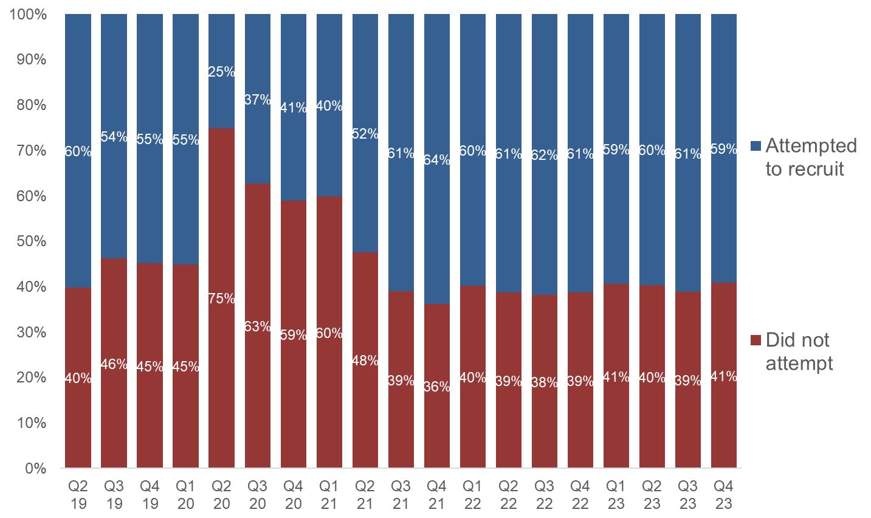
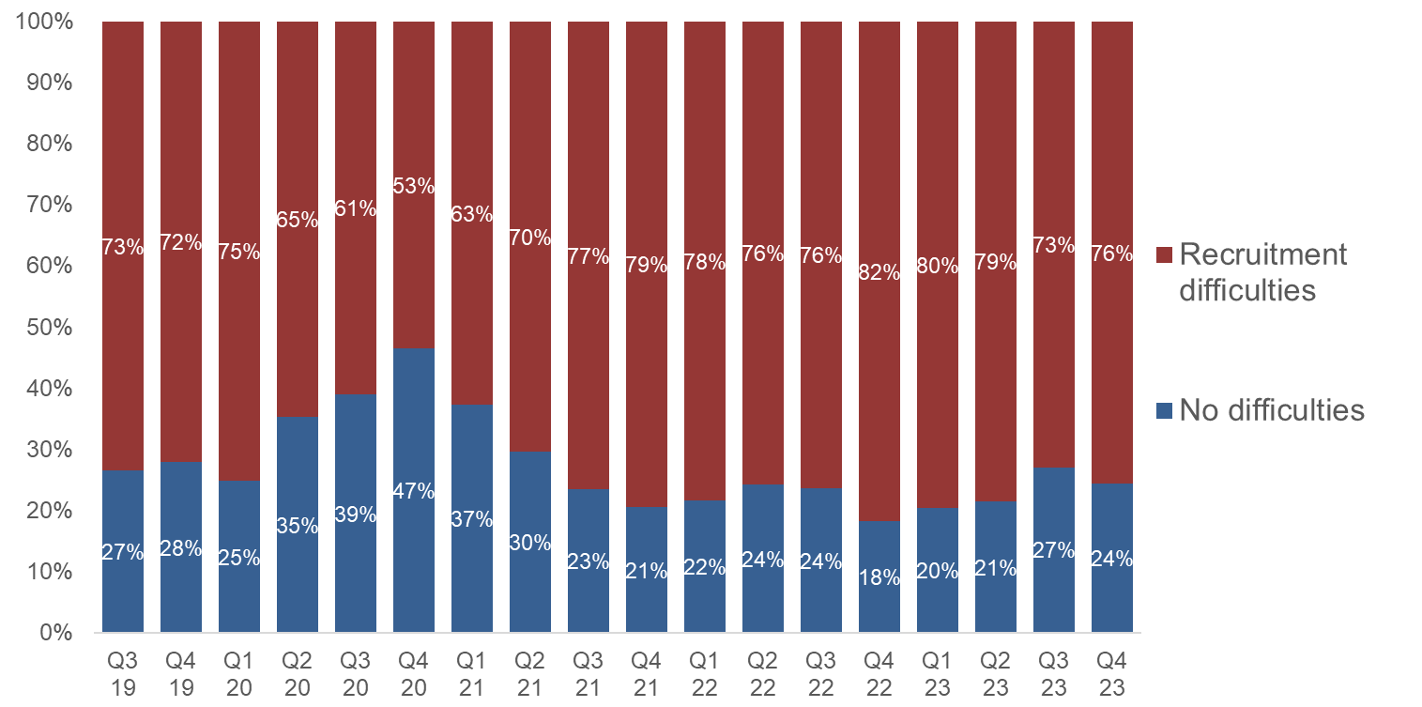
Labour market conditions remain broadly unchanged…
…with 59% of firms attempting to recruit and 76% of those firms facing recruitment difficulties. Hospitality (82%) and transport/logistics (81%) firms are the most likely to report difficulties.
Attempted recruitment
Recruitment difficulties
(Q: “Have you attempted to recruit staff over the past 3 months?” n=4,873)
(Q: “Did you experience any difficulties finding suitable staff?” n=2,881)

Slide 11
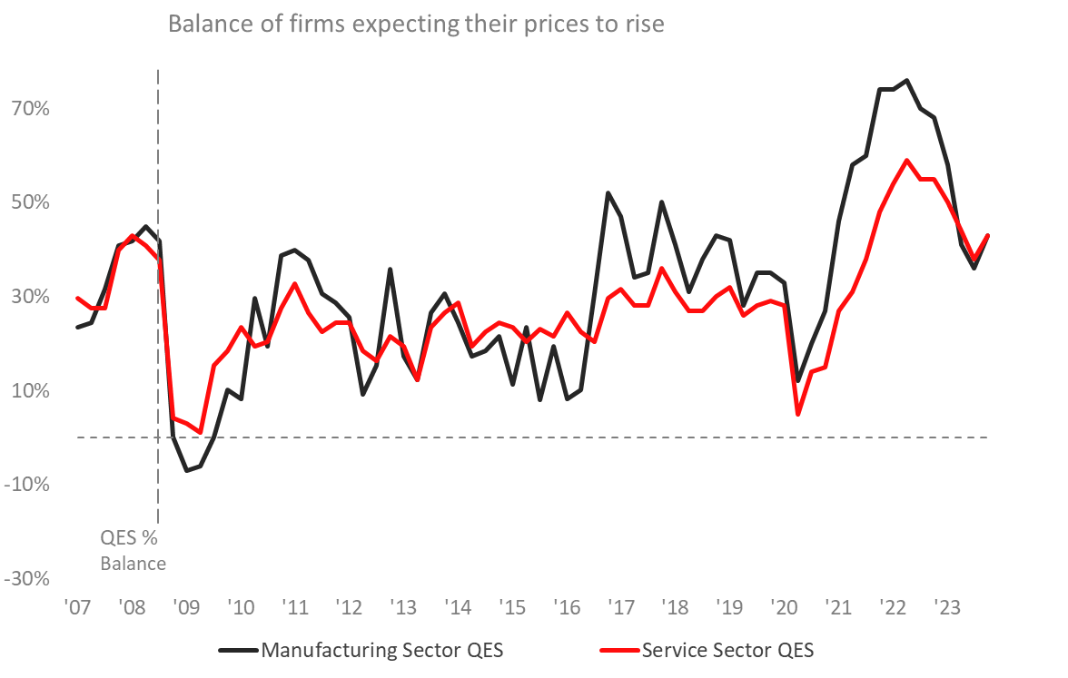
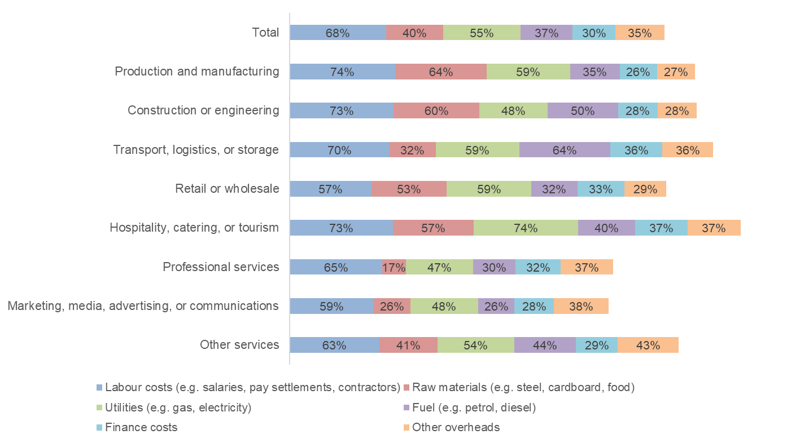
The downward trend in price expectations halts…
…as slightly more firms expect their prices to rise compared to last quarter. Labour costs are ranked the top source of cost pressure overall.
Price growth expectations
Source of cost pressures
(Q: “Over the next 3 months, do you expect the price of your good/services to...” n=4,752)
(Q: Is your business currently suffering pressures to raise its prices from any of the following? n=4,309)

Slide 12
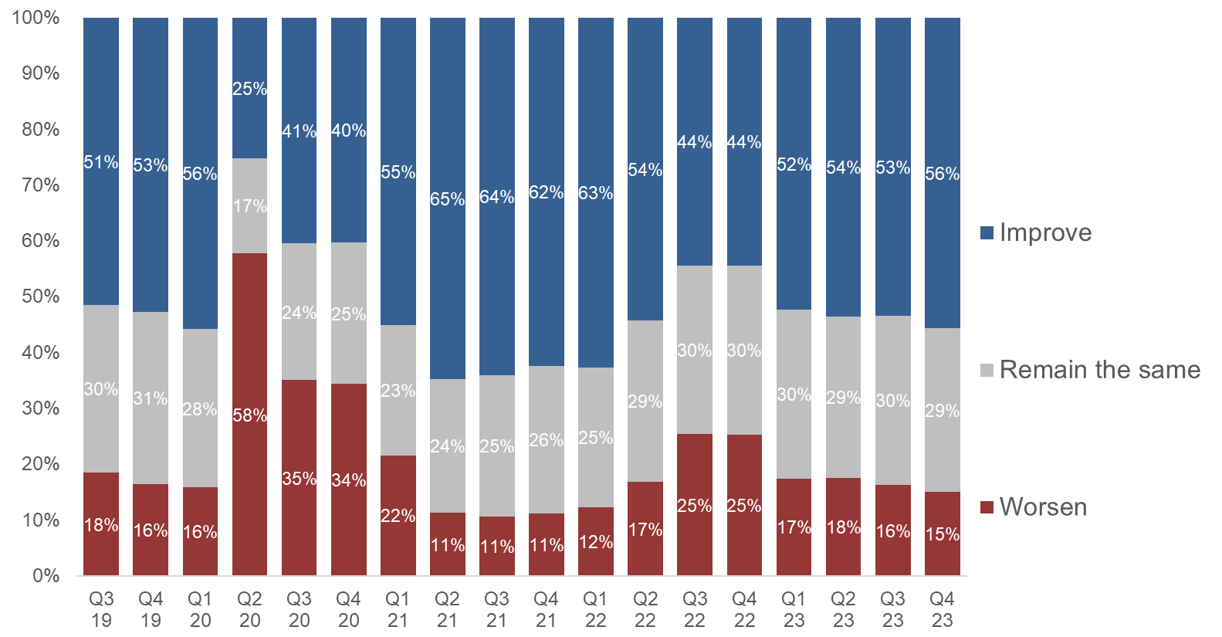
Business confidence improves…
…as more firms (56%) expect their turnover to increase over the next twelve months. B2B services sector is the most likely to expect an increase.
(Q: “Over the next 12 months, do you believe your business’s turnover will…” n=4,804)

Slide 13
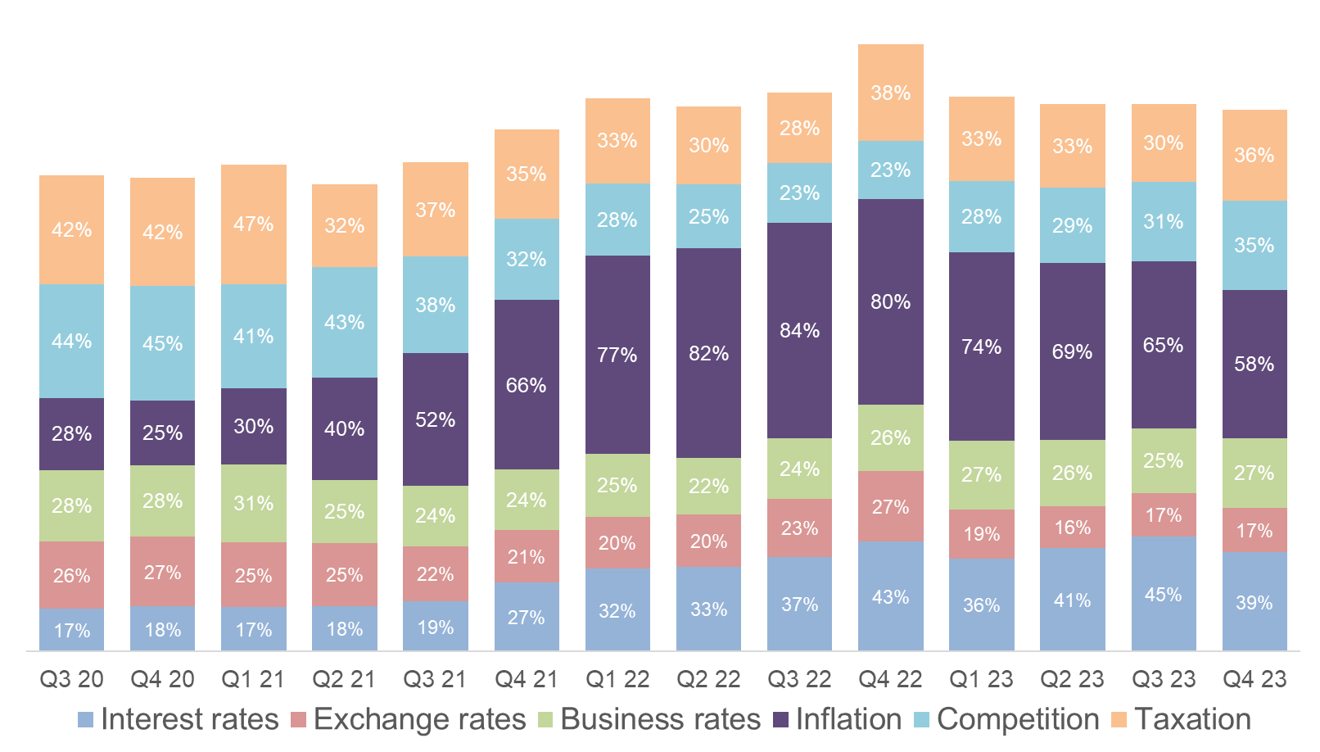
Concern about external factors has eased overall…
…with fewer firms worried about inflation and interest rates, although concern for both areas remains high by historical levels
Inflation
Interest rates
(Q: “Which of the following factors are more a concern to your business than 3 months ago?” n=4,130)

Slide 14
Monetary Policy
Where are we?
1st Feb – Bank of England’s Monetary Policy Committee (MPC) voted to keep the Bank Rate (Interest Rate) at 5.25%
Split decision – 6 voted for 5.25, 2 voted for 5.50 and 1 voted for 5.00
Last week, the BCC’s Economic Advisory Council (EAC) met and in a mock MPC vote, unanimously agreed that the
Bank Rate should be lowered by 0.25 points to 5.00% at the next MPC meeting in March.
Could the ONS GDP figures release on Thursday see us slip into a technical recession/does this matter?

Slide 15
Fiscal Policy
Where are we?
BCC has strong engagement levels with government at all levels, including with the PM, Chancellor, other Ministers, the
Shadow Cabinet, government departments and civil servants.
This is especially true currently given it is an election year (probably).
This engagement takes place as both continuous conversations as well as submissions for set piece events such as the
upcoming Spring Budget.

Slide 16
Budget Asks
Top 5
We need to build: Government to match industry-led funding of £3m for planning qualifications to help plug the lack of resource.
We need a consistent long-term skills plan: Developed by provision of long-term funding for the business-led, Local Skills Improvement Plans (LSIPs) beyond the current 2025 cut off point to at least 2028.
We need to support small businesses to grow: Government should restart the VAT registration review with a view to removing the existing cliff edge.

Slide 17
Budget Asks
Top 5
We need a fairer business tax system: Make Business Rates a tax that incentivises growth.
We need to keep UK PLC an attractive market for tourists, as well as businesses:
Government to reverse its recent policy on tax-free shopping which has impacted businesses of all sizes across the UK’s nations and regions.

Slide 18
Contact Details
CONTACT
Jonny Haseldine, Policy Manager
British Chambers of Commerce j.haseldine@britishchambers.org.uk

