Slide 1
Suffolk Chamber of Commerce, Economy Group invited talk
AI and the Suffolk Economy
Dr Kakia Chatsiou
Lecturer in Computing (k.chatsiou@uos.ac.uk)
13th February 2024
Notes:
I would like to thank you for the opportunity to discuss a subject I am very passionate about, that I teach at University of Suffolk and that I have been actively researching for the past 20 years: Artificial Intelligence. It has been transforming our world and has the potential to impact our local economy here in Suffolk.

Slide 2

Dr Kakia Chatsiou
Lecturer in Computing, University of Suffolk
k.chatsiou@uos.ac.uk
Teaching: Information Engineering, Distributed Systems and Cloud Computing, Cloud Computing for Data Science and AI
Research: Large Language Models, Generative AI, Sentiment Analysis/Opinion Mining, Multimodal Machine learning (text, audio, image and video data), Bioinformatics (ML with nucleotide sequencing data), Cloud computing, Emergency Response Information Systems, Financial and HR information systems, IoT for independent patient living, University of Suffolk Smart House projects, Computer vision for sports performance analytics
Find me on LinkedIn: https://www.linkedin.com/in/dr-kakia-chatsiou-37904423
Notes:
I am Dr Kakia Chatsiou, a Lecturer in Computing. My work primarily revolves around the development of innovative algorithms and models that enhance our understanding and application of AI and Machine technologies across different domains.
Recently, my focus has been on developing and applying automated, quantitative methodologies for the analysis of large and diverse forms of unstructured data. This includes a particular emphasis on political discourse and social media content, as well as extracting information and patterns from DNA/mRNA sequencing data using AI methods.
I have been involved in several interdisciplinary projects that leverage Text Analytics for information extraction and natural language understanding. These projects aim to elucidate the mechanisms underpinning digital transformation across various sectors - communities, businesses, and public sector entities - and investigate how data can serve as a catalyst for a more equitable, transparent, and accountable society.

Slide 3
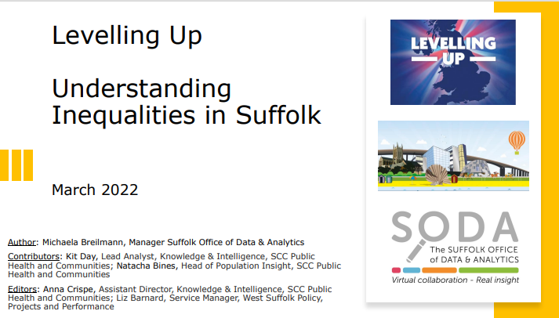
Suffolk: Key economy focus areas (missions)
1: Boost productivity, pay, jobs and living standards.
2: Increase domestic public investment in R&D
3: Improve local public transport connectivity
6: Increase the number of people successfully completing high-quality skills training
7: Narrow the gap in healthy life expectancy
8: Improve well-being in every area
https://www.suffolkobservatory.info/wp-content/uploads/2022/12/SODA_Levelling-Up-Understanding-Inequalities-in-Suffolk_March-2022.pdf
Notes:
Slide 2: Suffolk: Key economy focus areas
In their March 2022 paper, the Suffolk Office for Data Analytics (SODA) outlined 12 missions for Suffolk economy to achieve our region’s potential and reduce inequalities across a range of indicators. You can access the full report here: https://www.suffolkobservatory.info/wp-content/uploads/2022/12/SODA_Levelling-Up-Understanding-Inequalities-in-Suffolk_March-2022.pdf
Mission 1: Boost productivity, pay, jobs and living standards. Suffolk is a county of hard workers, with employment rates above the national average. However, we face challenges in the form of below-average wages, skills, and productivity. We must strive to address these inequalities, particularly in areas most affected by the COVID pandemic and the presence of US forces.
Mission 2: Increase domestic public investment in R&D. The East of England region, of which Suffolk is a part, has a high share of private sector R&D investment. However, we lag behind in public and higher education funding. We must strive to balance and diversify our sources of R&D spending to stimulate innovation and productivity growth.
Mission 3: Improve local public transport connectivity. Suffolk’s transport infrastructure relies heavily on buses, with limited rail and road connections. The COVID pandemic has led to a decline in bus usage, and travel times to key services and employment centres are longer than average. We must work towards improving our public transport connectivity to ensure that everyone in Suffolk can get where they need to go.
Mission 6: Increase the number of people successfully completing high-quality skills training. Suffolk has below-average adult skills levels, and lower rates of apprenticeship starts and achievements than the national average. This contributes to our low-wage and low-productivity profile. We must invest in high-quality skills training to provide opportunities for career progression and social mobility. The University of Suffolk is playing a great role in this, perhaps we can discuss this further later on.
Mission 7: Narrow the gap in healthy life expectancy. While Suffolk has a higher life expectancy than the national average, our healthy life expectancy is lower. This means that people in Suffolk spend more years in poor health, affecting their quality of life and wellbeing. We must work to narrow this gap, particularly between the most and least deprived areas, and between different groups of the population.
Mission 8: Improve well-being in every area. Suffolk has slightly lower well-being and life satisfaction ratings than the national average. The COVID pandemic has increased the number of people susceptible to stress or mental ill health, especially among younger, unemployed, and disadvantaged groups. We must strive to improve well-being in every area, for every resident of Suffolk.

Slide 4
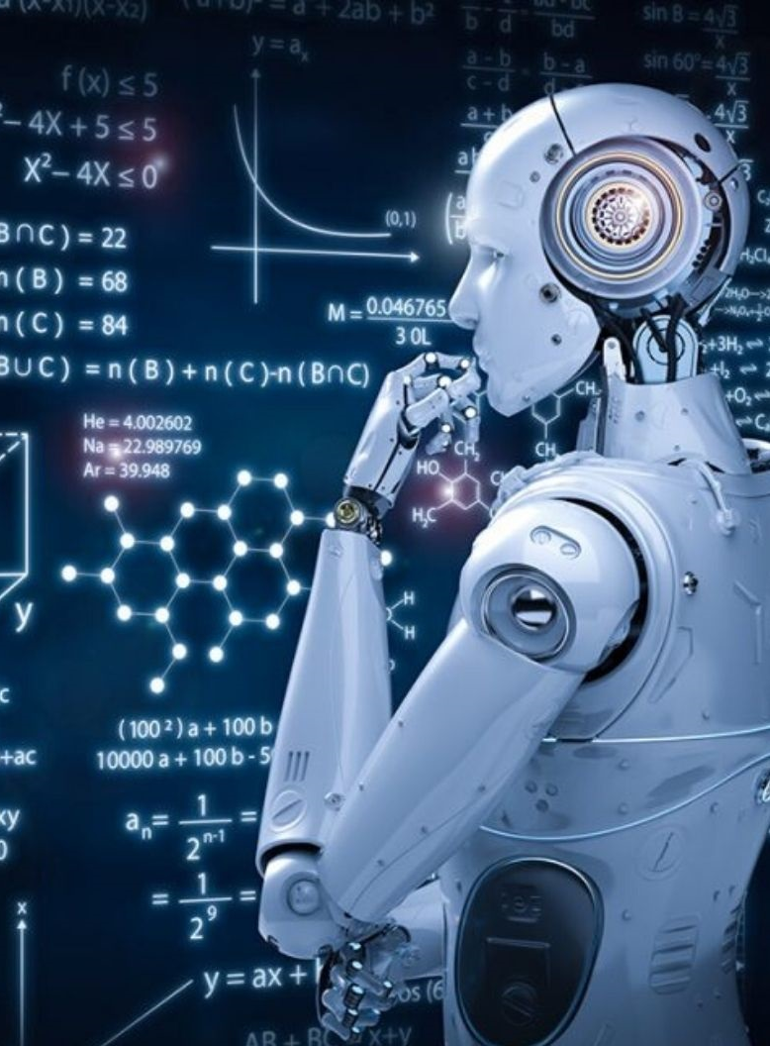
Can Digital Transformation and AI help?
Yes.
But what do we mean by AI?
computer systems capable of performing complex tasks that historically only a human could do, such as reasoning, making decisions, or solving problems.
These days: umbrella term encompassing an ecosystem of technologies, such as machine learning, deep learning, and natural language processing (NLP).
describes a wide range of technologies that power many of the services and goods we use every day.
Notes:
Slide 3: But what do we mean by AI?
Artificial Intelligence (AI) refers to computer systems capable of performing complex tasks that historically only a human could do, such as reasoning, making decisions, or solving problems.
Today, the term “AI” describes a wide range of technologies that power many of the services and goods we use every day. AI is an umbrella term that encompasses a wide variety of technologies, including machine learning, deep learning, and natural language processing (NLP)

Slide 5
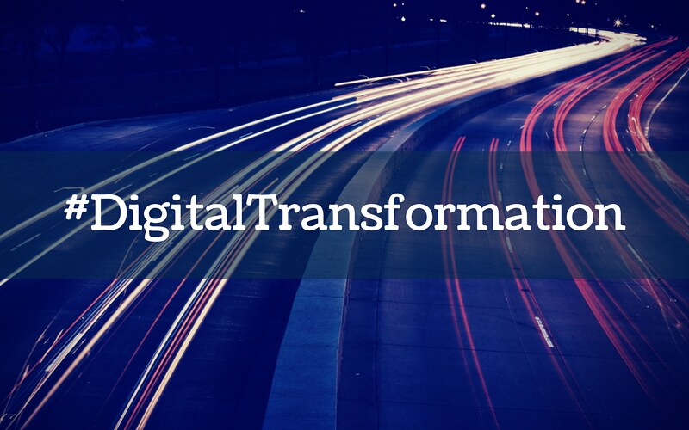
Can Digital Transformation and AI help?
What is digital transformation?
moving everything to digital
the integration of digital technology into all areas of a business
fundamentally changes how a business or organisation operates and delivers value to customers
requires organisations to continually challenge the status quo, experiment, and get comfortable with failure.
Notes:
Slide 4: Is AI similar to digital transformation?
Digital transformation is the integration of digital technology into all areas of a business, fundamentally changing how a business or organisation operates and delivers value to customers[1]. It's also a cultural change that requires organisations to continually challenge the status quo, experiment, and get comfortable with failure.
AI is the powerhouse that fuels digital transformation by enabling businesses to leverage advanced technologies to redefine their operational strategies, customer interactions, and value propositions[3]. It empowers organisations to reach new levels of efficiency, innovate products and services, and create enhanced user experiences.
Achieving digital maturity is crucial for businesses to fully benefit from AI[2]. Unless a business has a clear view of their business goals, digital strategy and digital assets, it cannot maximise its benefits from the use of AI technologies.

Slide 6
Can Digital Transformation and AI help?
Boosting Productivity and Skills Training:
automate routine tasks
free up resources for more complex and creative tasks
boost productivity
upskilling: provide personalised learning experiences
support those successfully completing high-quality skills training
Improving Healthy Life Expectancy and Well-being:
predictive analytics: identify health risks early
AI-powered telemedicine: healthcare accessible to all
personalised recommendations for improving mental health
used for diagnosis and treatment
Notes:
Slide 5: Can Digital Transformation and AI help?
Absolutely! Artificial Intelligence (AI) can play a significant role in helping to achieve these missions. Let’s explore how.
Boosting Productivity and Skills Training: AI can be used to automate routine tasks, freeing up human resources for more complex and creative tasks, thereby boosting productivity. In the realm of skills training, AI-powered platforms can provide personalised learning experiences, adapting to the learner’s pace and style. This can lead to more effective learning outcomes and increase the number of people successfully completing high-quality skills training.
Improving Healthy Life Expectancy and Well-being: AI has the potential to revolutionise healthcare. Predictive analytics can help identify health risks early, and AI-powered telemedicine can make healthcare more accessible. This could help increase healthy life expectancy. In terms of well-being, AI can provide personalised recommendations for improving mental health, based on user data.

Slide 7
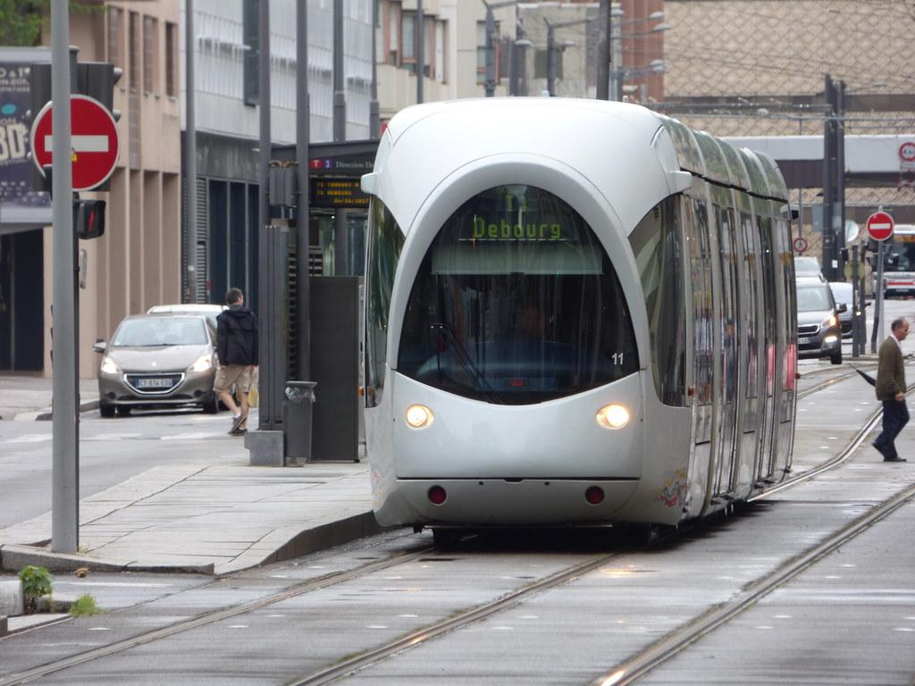
Can Digital Transformation and AI help?
Improving Public Transport
optimise routes and schedules
predict maintenance needs
improve the overall efficiency of the transport system
better connectivity
potentially increase usage of public transport.
Increasing R&D Investment
opportunity for funding from central government, technology funders and others to create digital infrastructure in the county
can identify promising areas for R&D investment by analysing trends and patterns in large datasets
Notes:
Increasing R&D Investment and Improving Public Transport: AI can help identify promising areas for R&D investment by analyzing trends and patterns in large datasets. In terms of public transport, AI can optimise routes and schedules, predict maintenance needs, and improve the overall efficiency of the transport system. This can lead to better connectivity and potentially increase usage of public transport.
Slide 6: What about GenAI?
Generative AI is a subset of AI that focuses on creating new content, whether it be text, images, or even code[13]. It's a powerful tool that has the potential to revolutionise many industries, including those that rely heavily on low-skilled jobs[10,11].
On the positive side, generative AI can help improve productivity, particularly for inexperienced or low-skilled workers [10,12]. For instance, a study by MIT Sloan found that contact center agents with access to a conversational assistant saw a 14% boost in productivity, with the largest gains impacting new or low-skilled workers[10]. In other words, the workers were upskilled, not replaced, thanks to the technology[10].
However, there are also potential negative impacts. The International Monetary Fund (IMF) has warned that AI could negatively affect around 40% of jobs around the world, potentially worsening inequality[11]. It's therefore crucial that we consider these potential impacts and take steps to mitigate them as we continue to develop and implement these technologies.

Slide 8

AI is helping us innovate
In agriculture:
monitoring crop health
predicting weather patterns
optimising irrigation
crop and soil monitoring
insect and plant disease detection
livestock health monitoring
intelligent spraying
automatic weeding
aerial survey and imaging, and produce grading and sorting
Notes:
Slide 7: Examples where AI is helping us innovate
As discussed previously, the UK Government's Levelling Up objectives aim to boost productivity, pay, jobs, and living standards, spread opportunities, improve public services, and implement devolution deals]. AI technologies can play a significant role in achieving these objectives. By improving efficiency and productivity in various sectors, AI can help create high-quality jobs and raise living standards. By spreading opportunities, it can ensure that the benefits of AI reach all parts of Suffolk. By improving public services like healthcare and education, it can enhance the well-being of our residents. And by supporting local businesses and industries, it can contribute to the devolution of power and resources.
In agriculture, AI-powered technologies are assisting our farmers in monitoring crop health, predicting weather patterns, and optimising irrigation. For instance, AI can be used for crop and soil monitoring, insect and plant disease detection, livestock health monitoring, intelligent spraying, automatic weeding, aerial survey and imaging, and produce grading and sorting[1].
(optional)
In healthcare, AI is enabling early diagnosis and personalised treatment plans, improving patient outcomes[4]. AI has been used to help diagnose COVID-19 from chest imaging and used to help secondary care dermatology referrals[8].

Slide 9

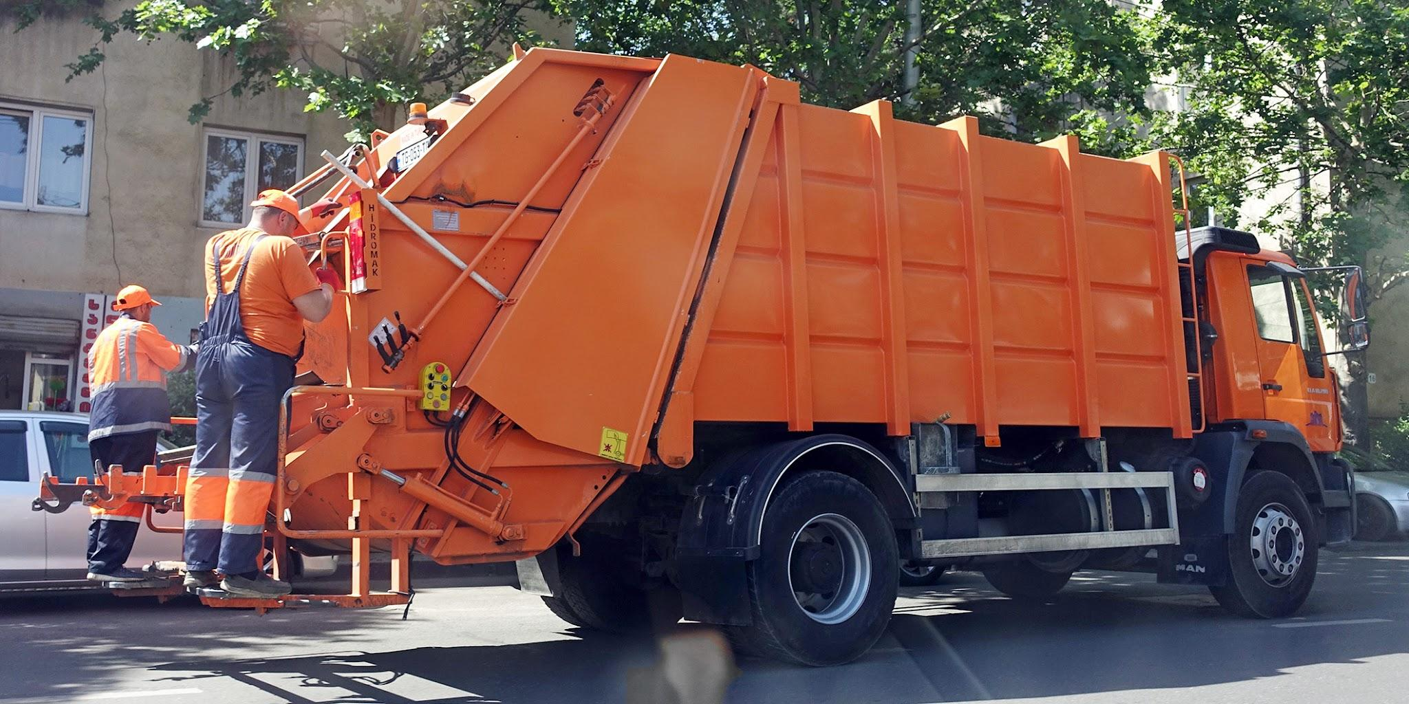
AI is helping us innovate
In waste management or gritting operations optimisation:
AI can develop detailed maps of each area
to find the best routes for their trucks, reducing travel time, fuel costs, and emissions.
used in smart bins,
waste-sorting robots,
waste generation models
waste monitoring and tracking
→ See: Smarter Suffolk Project (PI Prof Nicholas Caldwell): explore patterns in data collected via sensors all over the county on living conditions, weather monitoring and the environment
Notes:
In local authority services such as waste management or gritting operations optimisation, AI can develop detailed maps of each area they service to find the best routes for their trucks, reducing travel time, fuel costs, and emissions. AI can also be used in smart bins, waste-sorting robots, waste generation models, waste monitoring and tracking[9]. At the University of Suffolk, colleagues have worked closely with Suffolk County Council, and the BT, on the Smarter Suffolk Project to explore patterns in data collected via sensors all over the county on living conditions, weather monitoring and the environment

Slide 10

Concerns and cautionary tales
ensure benefits of AI are accessible to all (not priviledged)
Job displacement
Productivity and purpose to humans
Privacy concerns (security / safe AI)
explainable/transparent AI
AI education and training programmes
Raise awareness of technology
Long term effects in our work practices and local and global economies
regulation

Slide 11

Concluding thoughts
AI presents a a tremendous opportunity for economic growth in Suffolk.
potential to bring significant economic benefits
challenges need to be addressed (job displacement, misinformation, security, privacy)
needs strategic consideration: digital transformation, digital assets, innovation

Slide 12
Thank you! Questions?

Slide 13
Useful Reading
(1) The Role of Artificial Intelligence in Digital Transformation. https://www.ptc.com/en/blogs/corporate/artificial-intelligence-digital-transformation.
(2) Role of Artificial Intelligence in Digital Transformation. https://www.neweratech.com/us/blog/role-of-artificial-intelligence-business-digital-transformation/.
(3) How to implement an AI and digital transformation | McKinsey. https://www.mckinsey.com/capabilities/mckinsey-digital/our-insights/rewired-to-outcompete.
(4) Importance of AI in Digital Transformation - Silver Touch Technologies .... https://www.silvertouch.com/blog/importance-ai-digital-transformation/.
(5) AI for Small Business: 14 Tools and 7 Strategies | Birdeye. https://birdeye.com/blog/ai-for-small-businesses/.
(6) 3 Ways Small Businesses Can Use AI to Drive Growth. https://hbr.org/sponsored/2023/03/3-ways-small-businesses-can-use-ai-to-drive-growth.
(7) 10 ways local businesses can profit by AI - Medium. https://medium.com/@lars.vandedonk/10-ways-local-businesses-can-profit-by-ai-a5a11afb3f02.
(8) The Role of Artificial Intelligence in Digital Transformation for .... https://www.glueup.com/blog/artificial-intelligence-in-digital-transformation.
(9) Impact of Artificial Intelligence on Local Businesses. https://www.thedallasseocompany.com/blog/ai-on-local-businesses.
[10] Experimental Evidence on the Productivity Effects of Generative .... https://economics.mit.edu/sites/default/files/inline-files/Noy_Zhang_1.pdf.

Slide 14
Useful Reading
[11] A Comprehensive Review of Generative AI in Healthcare - arXiv.org. https://arxiv.org/pdf/2310.00795v1.pdf.
[12] Advancements in Generative AI: A Comprehensive Review of GANs, GPT .... https://arxiv.org/pdf/2311.10242v2.pdf.
[13] The great acceleration: CIO perspectives on generative AI | MIT .... https://www.technologyreview.com/2023/07/18/1076423/the-great-acceleration-cio-perspectives-on-generative-ai/.
[14] Workers with less experience gain the most from generative AI. https://mitsloan.mit.edu/ideas-made-to-matter/workers-less-experience-gain-most-generative-ai.
[15] AI will affect 40% of jobs and probably worsen inequality, says IMF .... https://www.theguardian.com/technology/2024/jan/15/ai-jobs-inequality-imf-kristalina-georgieva.
[16] Generative AI at Work | NBER. https://www.nber.org/papers/w31161.
[17] How the most recent AI wave affects jobs | LSE Business Review. https://blogs.lse.ac.uk/businessreview/2023/12/14/how-the-most-recent-ai-wave-affects-jobs/.
[18] Artificial intelligence’s great impact on low and middle-skilled jobs. https://www.bruegel.org/blog-post/artificial-intelligences-great-impact-low-and-middle-skilled-jobs.
[19] Generative AI: The Insights You Need from Harvard Business Review. https://www.hbsp.harvard.edu/product/10697-PDF-ENG.
[20] How Generative AI Is Changing Creative Work - Harvard Business Review. https://hbr.org/2022/11/how-generative-ai-is-changing-creative-work.

Slide 15
Useful Reading
(21) The economic impact of artificial intelligence on the UK economy - PwC UK. https://www.pwc.co.uk/economic-services/assets/ai-uk-report-v2.pdf.
(22) Generative AI and the labor market | Deloitte Insights. https://www2.deloitte.com/uk/en/insights/economy/generative-ai-impact-on-jobs.html.
(23) PwC's Global Artificial Intelligence Study | PwC. https://www.pwc.com/gx/en/issues/data-and-analytics/publications/artificial-intelligence-study.html.
(24) The potential impact of AI on UK employment and the demand for skills. https://www.gov.uk/government/publications/the-potential-impact-of-ai-on-uk-employment-and-the-demand-for-skills.
(25) The macroeconomic impact of artificial intelligence - PwC UK. https://www.pwc.co.uk/economic-services/assets/macroeconomic-impact-of-ai-technical-report-feb-18.pdf.
[26] A Comprehensive Review of Generative AI in Healthcare. https://arxiv.org/abs/2310.00795.

